Slide 1
SPORTS AND JOURNALISM
Introduction
Images and messages in sports media
Sports and Government
Media as a sources of propagation in sports
Media and the development of sports

Slide 2
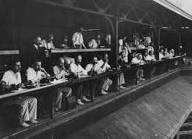
Sports and journalism
Sports journalism in the United States began in earnest in the 1820s and 1830s, with specialized sports magazines covering primarily horse racing and boxing. ... But by the end of the 19th century, newspapers would become the primary medium covering sport in America.

Slide 26
Media and development of sports
Sport development is a step toward national development. Due to affecting personal and social life, sport has attracted the attention of people and government. Mass media is an important means of sport development, which influence realizing most of sport development objectives.

